Slide 1
Review of Transmission Lines
Xiaoguang “Leo” Liu
Assistant Professor
Electrical and Computer Engineering
University of California, Davis
http://ucdart.net

Slide 2
Outline
Why transmission lines?
Examples of transmission lines
Modeling of transmission lines – the Telegrapher’s equation and the wave equation

Slide 3
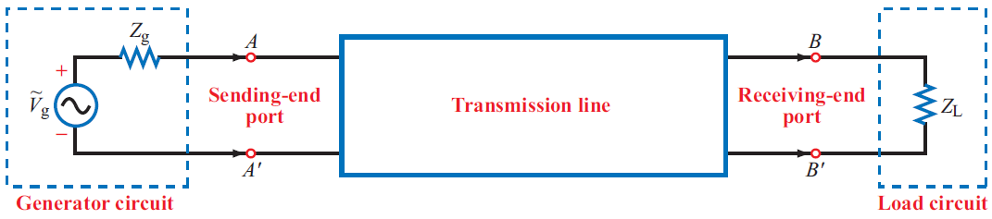
Transmission Lines
The term “transmission line” is usually reserved for high-frequency circuits
Can take many forms

Slide 4
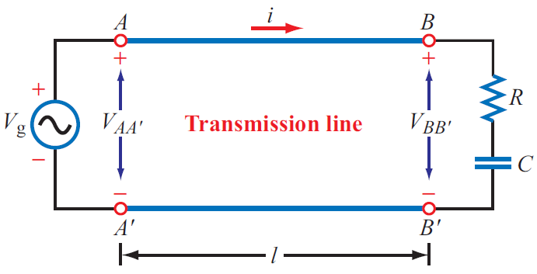
Why Transmission Lines?
Assume f₀ = 1 kHz

Slide 5
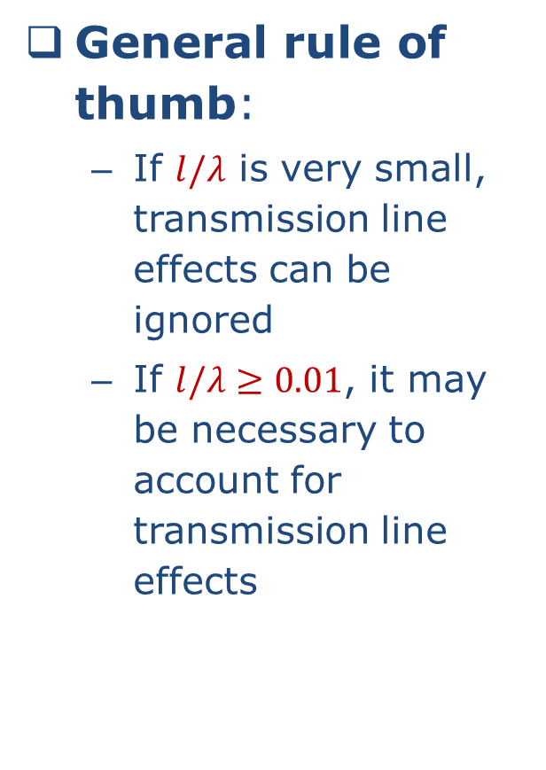
Why Transmission Lines?
General rule of thumb:
If $l/λ$ is very small, transmission line effects can be ignored
If $l/λ≥0.01$, it may be necessary to account for transmission line effects

Slide 6
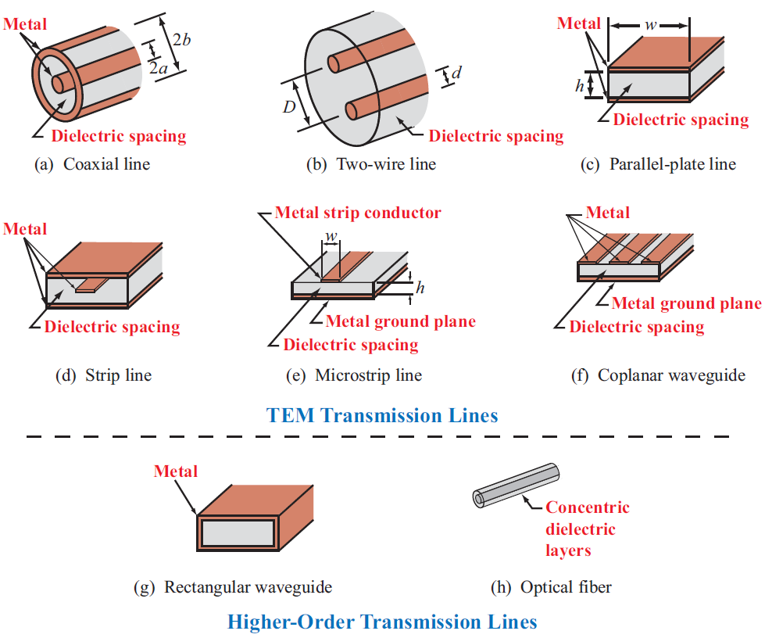
Types of Transmission Lines

Slide 7
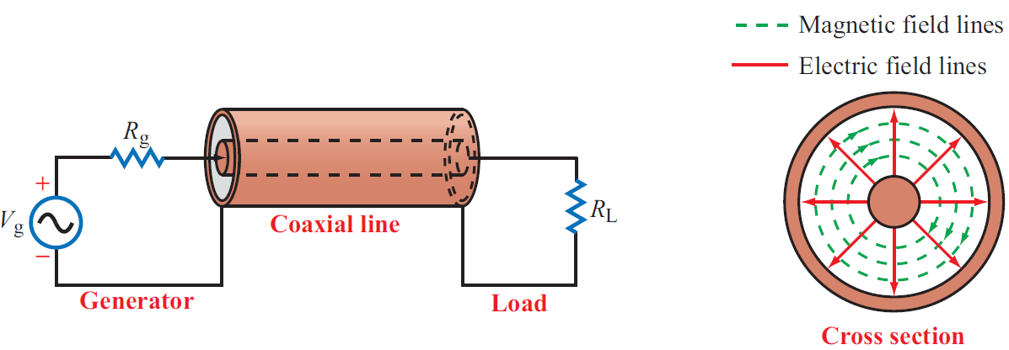
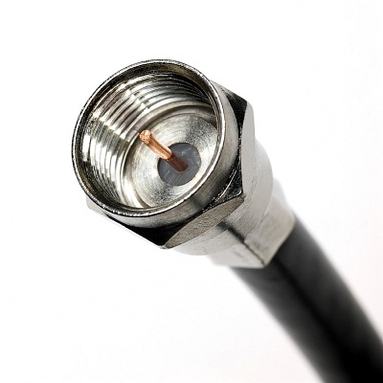
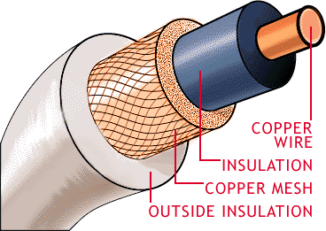
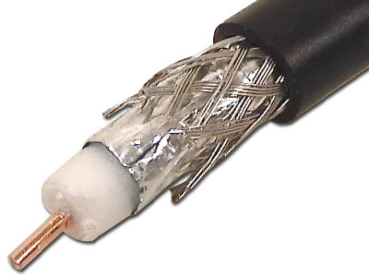
Coaxial Lines
Consist of a center conductor and a ground shield
Provide very good shielding of the signal, extremely small leakage

Slide 8
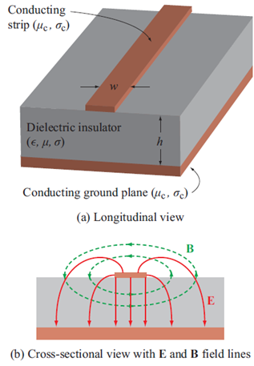
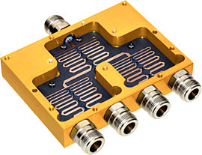
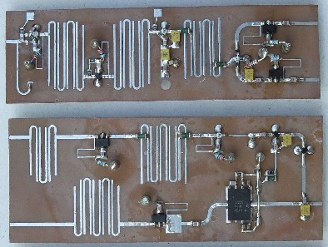
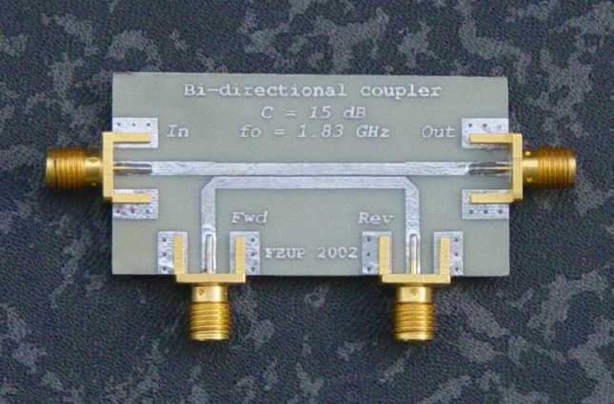
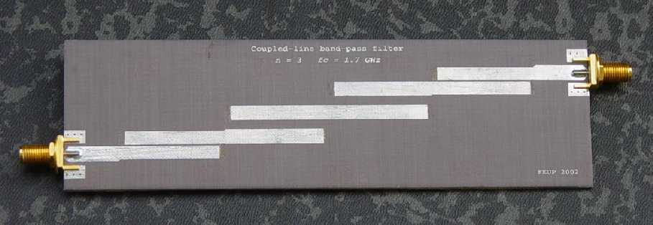
Microstrip Line
Fabricated on an insulating substrate
Easy to integrate with other circuit components

Slide 9
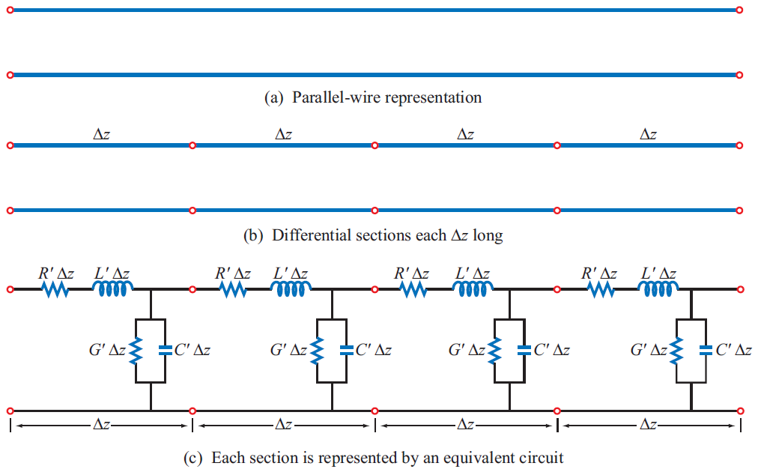
Modeling of Transmission Lines

Slide 10
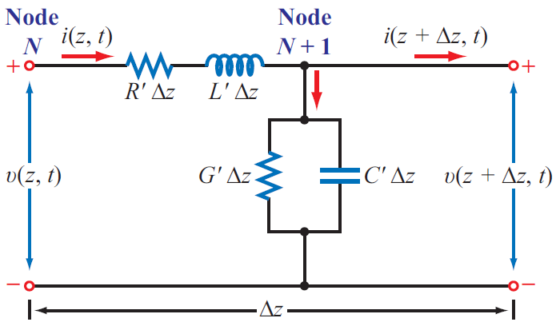
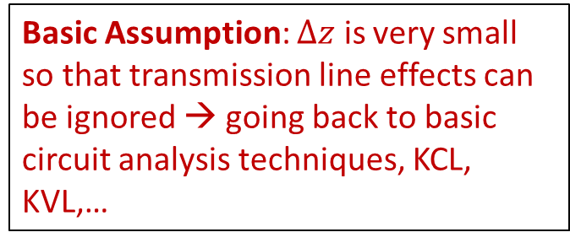
Modeling of Transmission Lines
Basic Assumption: $∆z$ is very small so that transmission line effects can be ignored → going back to basic circuit analysis techniques, KCL, KVL,…

Slide 12
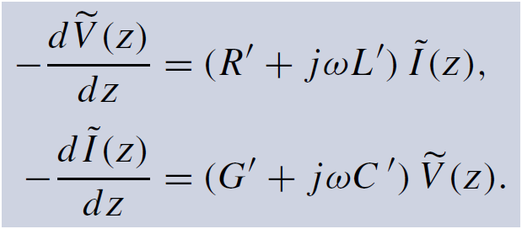
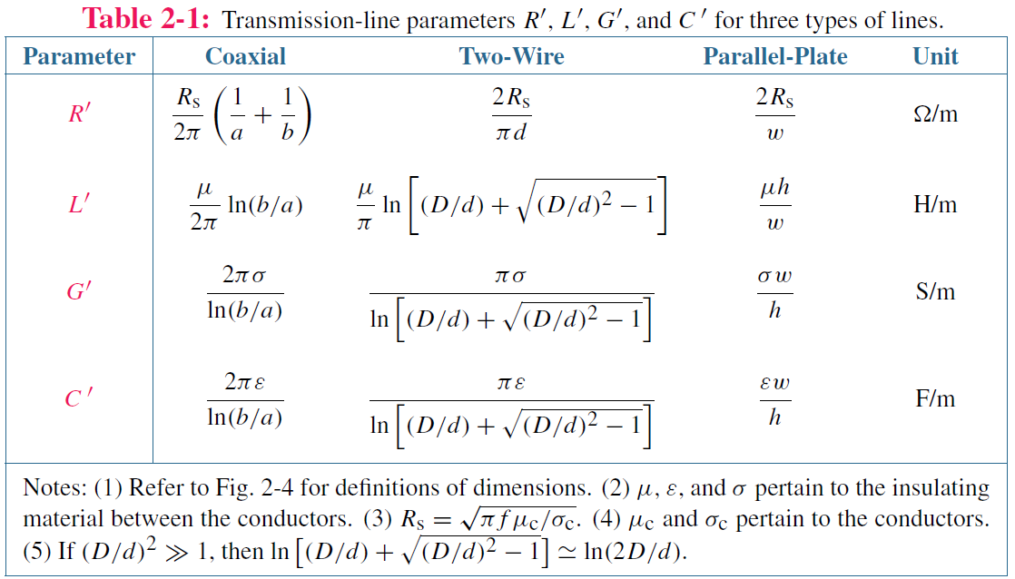
Telegrapher’s Equations

Slide 13
Derivation of Wave Equations

Slide 14
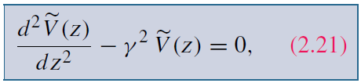
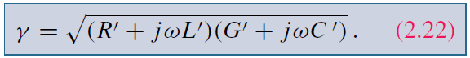
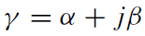
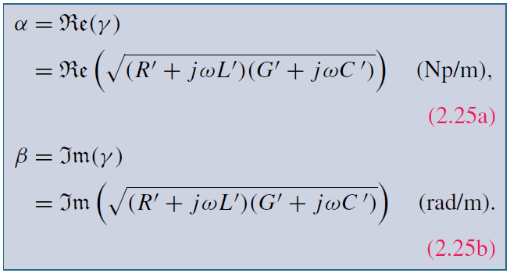
Wave Equations

Slide 15
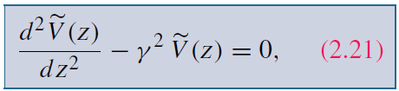
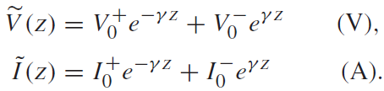
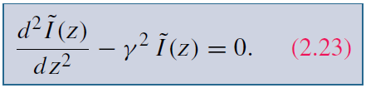
Solution of Wave Equations
General solution

Slide 16
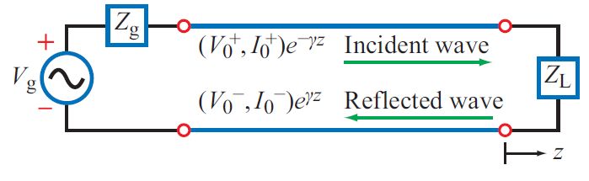
Solution of Wave Equations
General solution

Slide 17
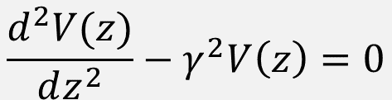
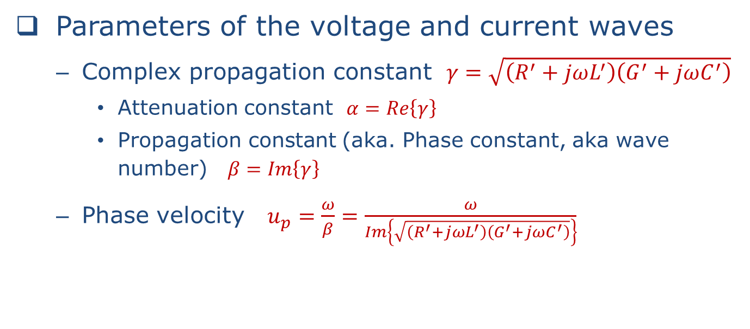
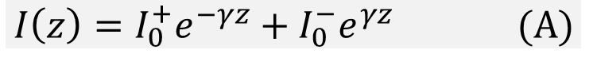
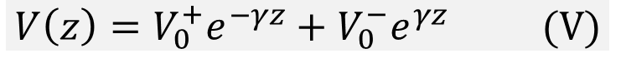
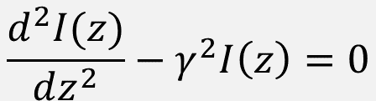
Solution to Wave Equations
$$\frac{d^{2}V(z)}{dz^{2}}−γ^{2}V\left(z\right)=0$$
$$V\left(z\right)=V_{0}^{+}e^{−γz}+V_{0}^{−}e^{γz} (V)$$
$$\frac{d^{2}I(z)}{dz^{2}}−γ^{2}I\left(z\right)=0$$
$$I\left(z\right)=I_{0}^{+}e^{−γz}+I_{0}^{−}e^{γz} (A)$$
Parameters of the voltage and current waves
Complex propagation constant $γ=\sqrt{\left(R^{′}+jωL^{′}\right)\left(G^{′}+jωC^{′}\right)}$
Attenuation constant $α=Re\left\{γ\right\}$
Propagation constant (aka. Phase constant, aka wave number) $β=Im\left\{γ\right\}$
Phase velocity $u_{p}=\frac{ω}{β}=\frac{ω}{Im\left\{\sqrt{\left(R^{′}+jωL^{′}\right)\left(G^{′}+jωC^{′}\right)}\right\}}$

Slide 18
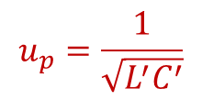
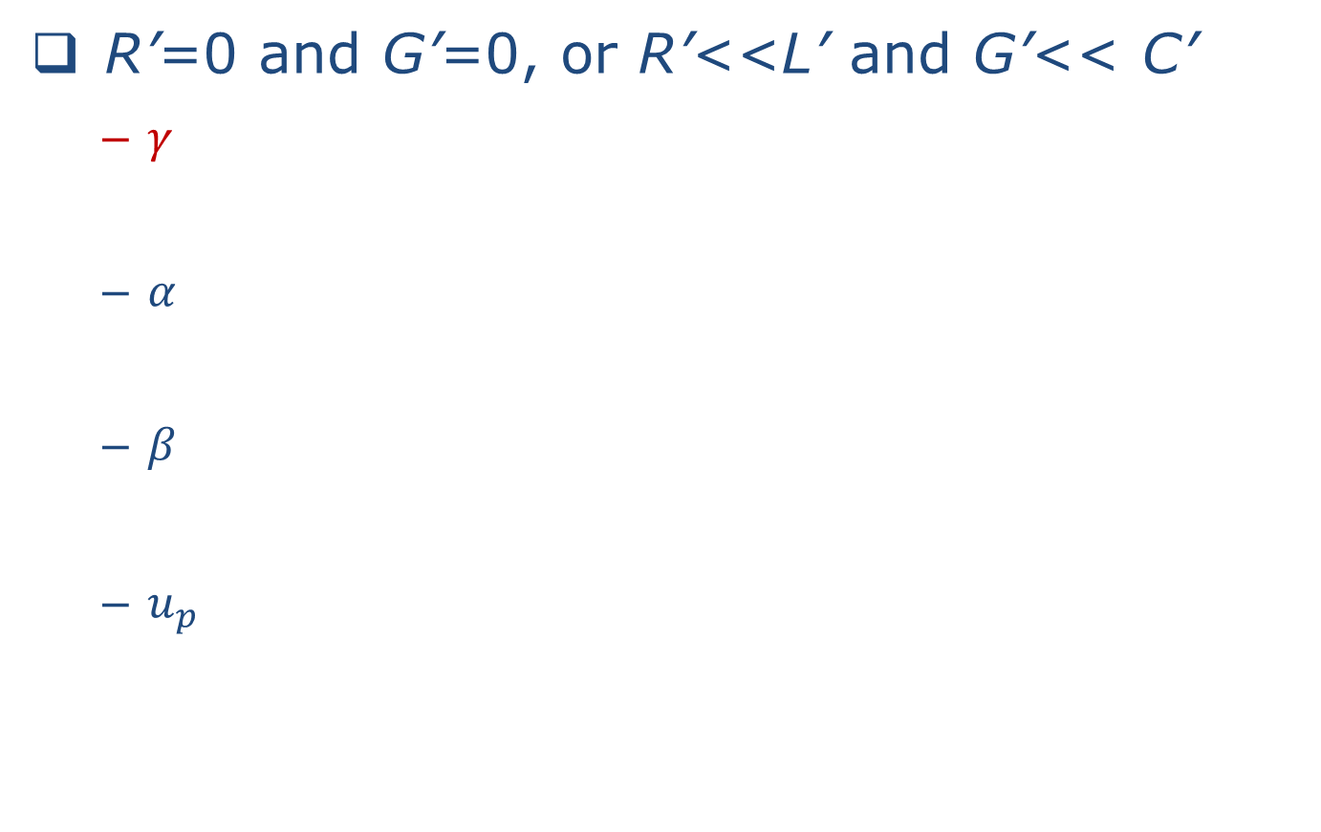
Lossless Transmission Line
R’=0 and G’=0, or R’<<L’ and G’<< C’
$γ$
$α$
$β$
$u_{p}$
$$u_{p}=\frac{1}{\sqrt{L^{′}C^{′}}}$$
Phase velocity is independent of frequency!

Slide 19
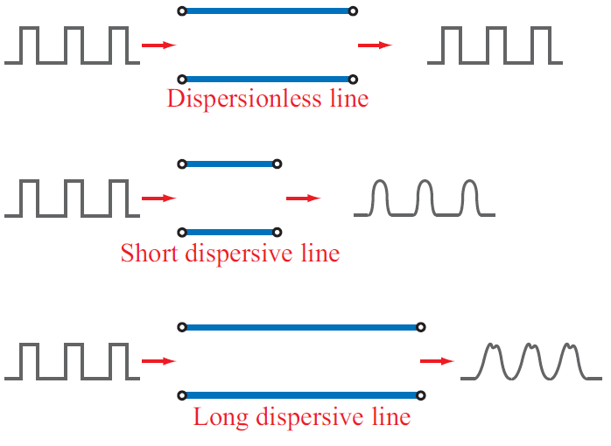
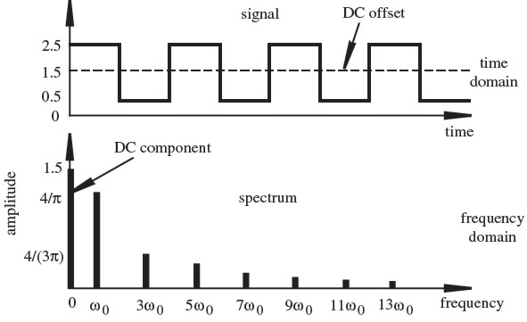
Dispersion
For lossy lines, phase velocity is usually a function of frequency
This may cause problems if you have more than one frequencies to transmit; signals would arrive at different time if they have different frequencies! – This is called dispersion.
Example: Digital signals contain a lot of frequency components

Slide 20
Solution to Wave Equations
$$\frac{d^{2}V(z)}{dz^{2}}−γ^{2}V\left(z\right)=0$$
$$V\left(z\right)=V_{0}^{+}e^{−γz}+V_{0}^{−}e^{γz} (V)$$
$$\frac{d^{2}I(z)}{dz^{2}}−γ^{2}I\left(z\right)=0$$
$$I\left(z\right)=I_{0}^{+}e^{−γz}+I_{0}^{−}e^{γz} (A)$$
Is there any relationship between voltage and current?

Slide 21
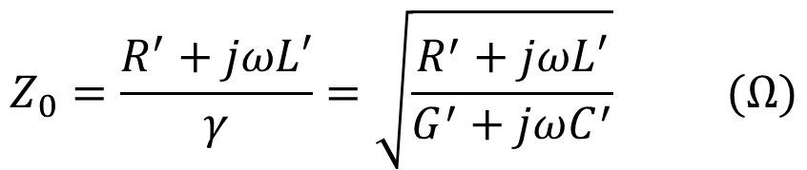
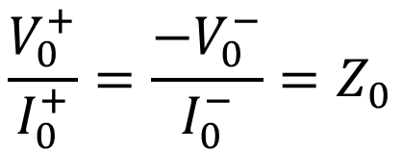
Characteristic Impedance
$$Z_{0}=\frac{R^{′}+jωL′}{γ}=\sqrt{\frac{R^{′}+jωL′}{G^{′}+jωC^{′}}} (Ω)$$
$$\frac{V_{0}^{+}}{I_{0}^{+}}=\frac{{−V}_{0}^{−}}{I_{0}^{−}}=Z_{0}$$

Slide 22
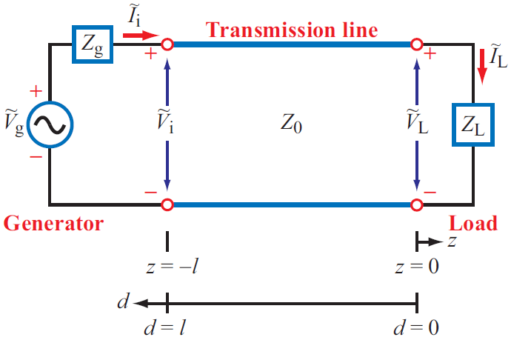
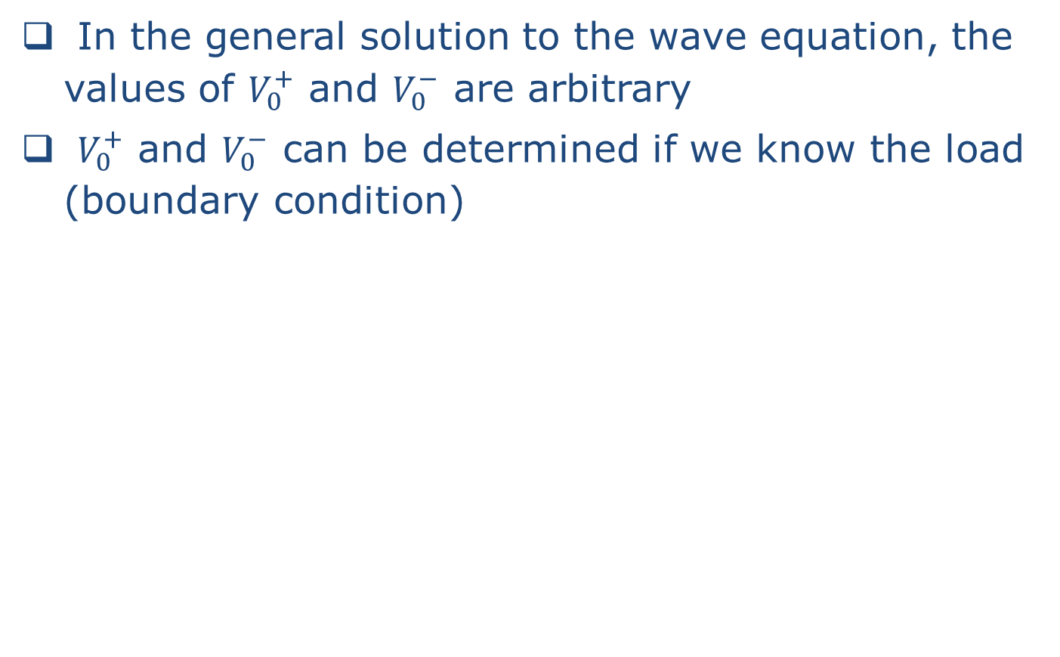

How Do We Determine $V_{0}^{+}$ and $V_{0}^{−}$?
In the general solution to the wave equation, the values of $V_{0}^{+}$ and $V_{0}^{−}$ are arbitrary
$V_{0}^{+}$ and $V_{0}^{−}$ can be determined if we know the load (boundary condition)

Slide 24
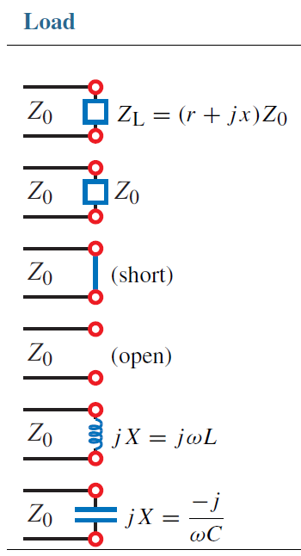

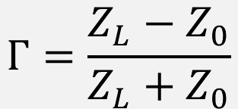
Voltage Reflection Coefficient ($Γ$)
$$Γ=\frac{Z_{L}−Z_{0}}{Z_{L}+Z_{0}}$$

Slide 25
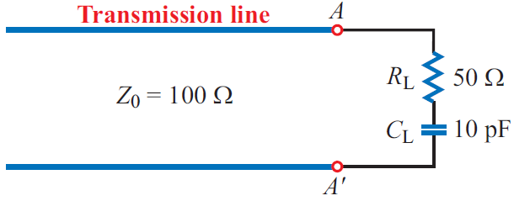
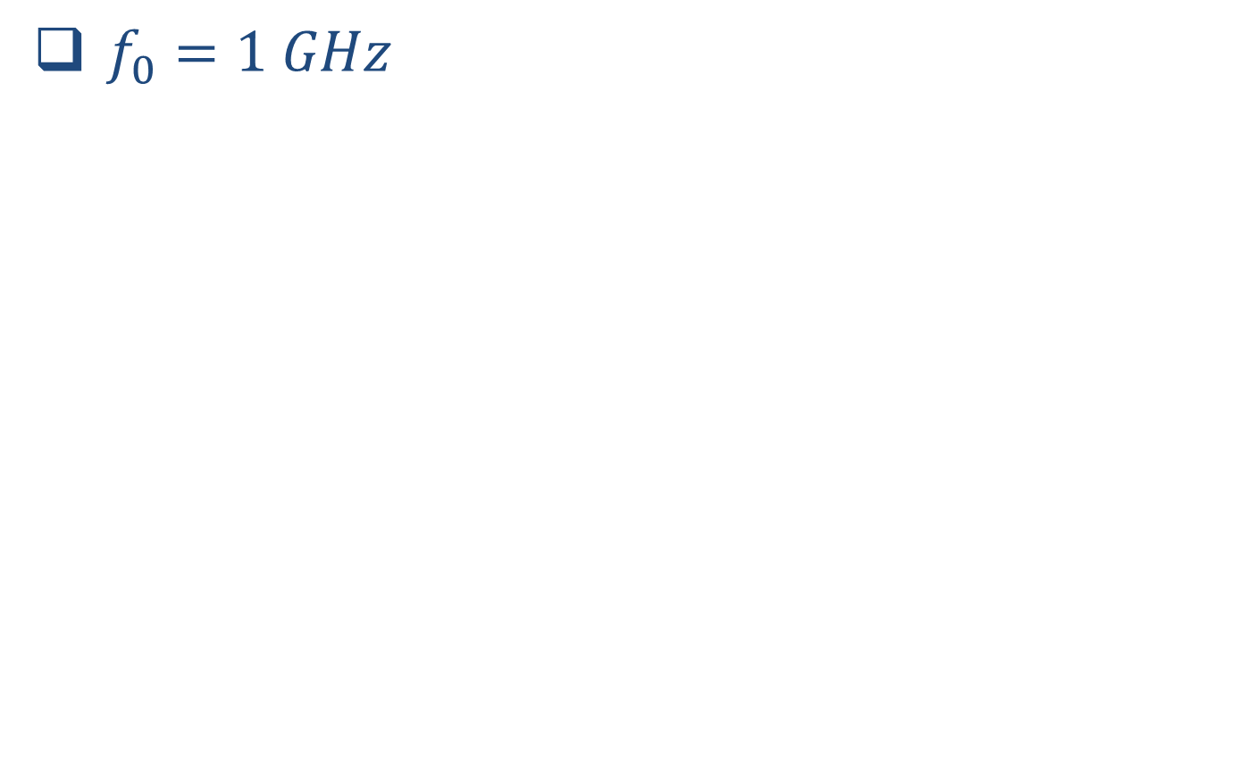
Example
$f_{0}=1 GHz$

Slide 26
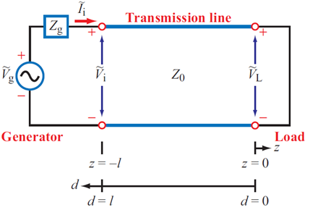
Standing Waves
A simple example: Z_{L}=0

Slide 27
Standing Waves
Youtube video: http://www.youtube.com/watch?v=NpEevfOU4Z8

Slide 28
Standing Waves
More general case

Slide 29
Standing Waves
More general case
$$V\left(d\right)=\left|V_{0}^{+}\right|{\left[1+{\left|Γ\right|}^{2}+2\left|Γ\right|\cos\left(2βd−θ_{r}\right)\right]}^{\frac{1}{2}}$$
$$I\left(d\right)=\left|I_{0}^{+}\right|{\left[1+{\left|Γ\right|}^{2}−2\left|Γ\right|\cos\left(2βd−θ_{r}\right)\right]}^{\frac{1}{2}}$$

Slide 30
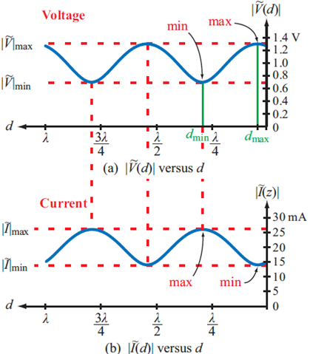
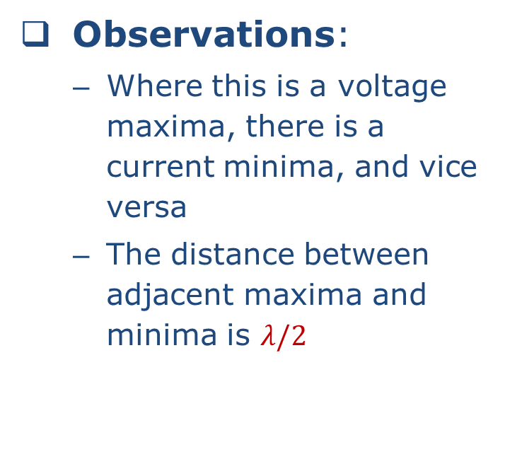
Voltage (& Current) Maximas & Minimas
$$V\left(d\right)=\left|V_{0}^{+}\right|{\left[1+{\left|Γ\right|}^{2}+2\left|Γ\right|\cos\left(2βd−θ_{r}\right)\right]}^{\frac{1}{2}}$$
$$I\left(d\right)=\left|I_{0}^{+}\right|{\left[1+{\left|Γ\right|}^{2}−2\left|Γ\right|\cos\left(2βd−θ_{r}\right)\right]}^{\frac{1}{2}}$$
Observations:
Where this is a voltage maxima, there is a current minima, and vice versa
The distance between adjacent maxima and minima is $λ/2$

Slide 31
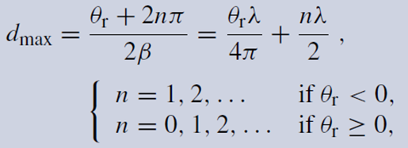
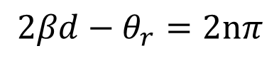
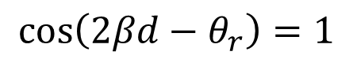
Voltage (& Current) Maximas & Minimas
$$V\left(d\right)=\left|V_{0}^{+}\right|{\left[1+{\left|Γ\right|}^{2}+2\left|Γ\right|\cos\left(2βd−θ_{r}\right)\right]}^{\frac{1}{2}}$$
$$I\left(d\right)=\left|I_{0}^{+}\right|{\left[1+{\left|Γ\right|}^{2}−2\left|Γ\right|\cos\left(2βd−θ_{r}\right)\right]}^{\frac{1}{2}}$$
Voltage maximum is achieved when
$$\cos\left(2βd−θ_{r}\right)=1$$
that is
$$2βd−θ_{r}=2nπ$$

Slide 32
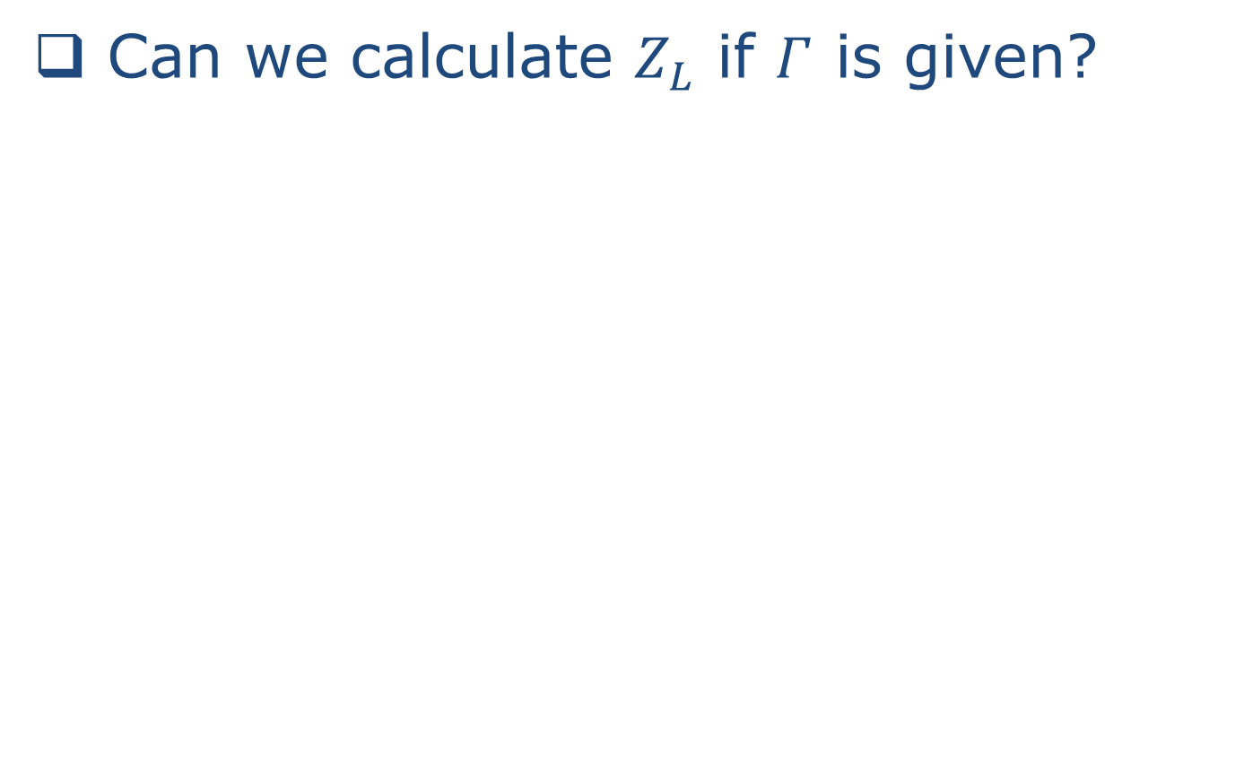
Reflection Coefficient
Can we calculate $Z_{L}$ if $Γ$ is given?

Slide 33
Standing Wave
$$V\left(d\right)=\left|V_{0}^{+}\right|{\left[1+{\left|Γ\right|}^{2}+2\left|Γ\right|\cos\left(2βd−θ_{r}\right)\right]}^{\frac{1}{2}}$$
$$I\left(d\right)=\left|I_{0}^{+}\right|{\left[1+{\left|Γ\right|}^{2}−2\left|Γ\right|\cos\left(2βd−θ_{r}\right)\right]}^{\frac{1}{2}}$$
Observations:
Where this is a voltage maxima, there is a current minima, and vice versa
The distance between adjacent maxima and minima is $λ/2$

Slide 34
Voltage (& Current) Maximas & Minimas
$$V\left(d\right)=\left|V_{0}^{+}\right|{\left[1+{\left|Γ\right|}^{2}+2\left|Γ\right|\cos\left(2βd−θ_{r}\right)\right]}^{\frac{1}{2}}$$
$$I\left(d\right)=\left|I_{0}^{+}\right|{\left[1+{\left|Γ\right|}^{2}−2\left|Γ\right|\cos\left(2βd−θ_{r}\right)\right]}^{\frac{1}{2}}$$
Voltage maximum is achieved when
$$\cos\left(2βd−θ_{r}\right)=1$$
that is
$$2βd−θ_{r}=2nπ$$

Slide 35

Standing Waves

Slide 36


Standing Wave Ratio (SWR)
Sometimes called Voltage Standing Wave Ratio (VSWR)
For a matched load
For a short, open, or purely reactive load

Slide 37

Example
$Z_{0}=50 Ω, Z_{L}=50+j25, f_{0}=1 GHz, u_{p}=c$
$Γ?$
$VSWR?$
$d_{V,max}?$

Slide 38



Wave Impedance
$$V\left(z\right)=V_{0}^{+}e^{−γz}+V_{0}^{−}e^{γz} (V)$$
$$I\left(z\right)=I_{0}^{+}e^{−γz}+I_{0}^{−}e^{γz} (A)$$

Slide 40

Input Impedance – Input Reflection Coefficient

Slide 41
Input Reflection Coefficient
An alternative approach

Slide 42
Input Reflection Coefficient
An alternative approach

Slide 43
Some Interesting Examples
Short
Open

Slide 44
Some Interesting Examples
Match
λ/2
λ/4

Slide 45

Smith Chart

Slide 46
Smith Chart
Let
and
Notice that these two equations represent circles on the Γ plane

Slide 47




Smith Chart
Smith chart is plotted on the $Γ$ plane, i.e. complex plane
Horizontal axis is the real part of $Γ$
Vertical axis is the imaginary part of $Γ$
$Γ$ is bound within the unit circle
$$Γ_{i}$$
$$Γ=Γ_{r}+Γ_{i}$$
$$Γ_{r}$$

Slide 48






Constant-r Circles
$${\left(Γ_{r}−\frac{r_{L}}{1+r_{L}}\right)}^{2}+Γ_{i}^{2}={\left(\frac{1}{1+r_{L}}\right)}^{2}$$
$r_{L}=0$ → $Z_{L}=jX_{L}$
$$Γ_{i}$$
$r_{L}=∞$
$$Γ_{r}$$
$$r_{L}=1$$

Slide 49





Constant-x Circles
$${\left(Γ_{r}−1\right)}^{2}+{\left(Γ_{i}−\frac{1}{x_{L}}\right)}^{2}={\left(\frac{1}{x_{L}}\right)}^{2}$$
$$x_{L}=1$$
$$Γ_{i}$$
$x_{L}=∞$
$$Γ_{r}$$
$$x_{L}=0$$
$$x_{L}=−1$$

Slide 50



Complete Smith Chart
Combines constant-r circles and constant-x circles
$$Γ_{i}$$
+
j
1
.
0
+
j
0
.
5
+
j
2
.
0
+
j
0
.
2
+
j
5
.
0
2
5
0
0
0
.
.
.
.
.
0
0
0
1
2
5
.
0
$$Γ_{r}$$
j
0
.
2
j
5
.
0
Phillip Smith
j
0
.
5
j
2
.
0
j
1
.
0
Read a brief biography of Philip Smith: http://sss-mag.com/smith01.html

Slide 51


Examples
$$Γ_{i}$$
+
j
1
.
0
Z_{L} = 10+j25 Ω
+
j
0
.
5
+
j
2
.
0
z_{L} = 0.2+j0.5
+
j
0
.
2
+
j
5
.
0
125°
Γ_{L} = 0.725/125°
0.725
2
5
0
0
0
.
.
.
.
.
0
0
0
1
2
5
.
0
$$Γ_{r}$$
Open?
Short?
Matched Load?
j
0
.
2
j
5
.
0
j
0
.
5
j
2
.
0
j
1
.
0

Slide 52
Examples
$$Γ_{i}$$
+
j
1
.
0
+
j
0
.
5
+
j
2
.
0
+
j
0
.
2
+
j
5
.
0
2
5
0
0
0
.
.
.
.
.
0
0
0
1
2
5
.
0
$$Γ_{r}$$
j
0
.
2
j
5
.
0
j
0
.
5
j
2
.
0
j
1
.
0

Slide 53

What Can You Do with Smith Chart?
Convert load impedance and reflection
Graphically calculate $Z_{in}$ and $Γ_{in}$
Calculate VSWR
Impedance matching with lumped and distributed elements

Slide 54







Adding Transmission Line to the Load
$$2βl$$
$$Γ_{i}$$
+
j
1
.
0
+
Towards the
generator
j
0
.
5
+
j
2
.
0
$$Γ_{L}$$
$$Γ_{in}$$
Recall that
no change in magnitude; only change in phase
Phase change by $2βl$
+
j
0
.
2
+
j
5
.
0
$$Γ_{in}=Γ_{0}e^{−2jβl}$$
2
5
0
0
0
.
.
.
.
.
0
0
0
1
2
5
.
0
$$Γ_{r}$$
j
0
.
2
j
5
.
0
Constant-VSWR Circle
j
0
.
5
j
2
.
0
j
1
.
0

Slide 55

Adding Transmission Line to the Load
$$2βl$$
$$Γ_{i}$$
+
j
1
.
0
+
Towards the
generator
j
0
.
5
+
j
2
.
0
$$Γ_{L}$$
$$Γ_{in}$$
+
j
0
.
2
+
j
5
.
0
Adding a length l of transmission line to the load moves the reflection coefficient on a constant-VSWR circle by $2βl$
Moving “towards the generator” moves clockwise
2
5
0
0
0
.
.
.
.
.
0
0
0
1
2
5
.
0
$$Γ_{r}$$
j
0
.
2
j
5
.
0
Constant-VSWR Circle
j
0
.
5
j
2
.
0
j
1
.
0

Slide 56

Constant-VSWR Circle
$$Γ_{i}$$
+
j
1
.
0
+
j
0
.
5
+
j
2
.
0
$$Γ_{L}$$
+
j
0
.
2
+
j
5
.
0
Any point on the constant-VSWR circle has the same VSWR---because the $\left|Γ\right|$ is the same
360° is $λ/2$
Voltage maxima & minima positions are intersects of the constant-VSWR circle with the $Γ_{r}$ axis
2
5
0
0
0
.
.
.
.
.
0
0
0
1
2
5
.
0
$$Γ_{r}$$
j
Voltage Minima
Voltage Maxima
0
.
2
j
5
.
0
j
0
.
5
j
2
.
0
j
1
.
0

Slide 57


Voltage Maxima & Minima
$$2βd_{v, \max{}}$$
$$2βd_{v,max}=θ_{r}+2nπ$$
$$Γ_{i}$$
+
j
1
.
0
+
j
0
.
5
+
j
2
.
0
$$Γ_{L}$$
+
j
0
.
2
+
j
5
.
0
2
5
0
0
0
.
.
.
.
.
0
0
0
1
2
5
Reflection coefficient and wave impedance at the voltage maxima & minima points are all real number (How to prove it?)
.
0
$$Γ_{r}$$
j
Voltage Minima
Voltage Maxima
0
.
2
j
5
.
0
j
0
.
5
j
2
.
0
j
1
.
0

Slide 58



Finding VSWR – A Trick
$$Γ_{i}$$
+
Find the voltage maxima point
Identify the constant-r circle that the voltage maxima point is on
The r value of the constant-r circle is the VSWR value!
j
1
.
0
+
j
0
.
5
+
j
2
.
0
$$Γ_{L}$$
+
j
0
.
2
+
j
5
.
0
2
5
0
0
0
.
.
.
.
.
0
0
0
1
2
5
.
0
$$Γ_{r}$$
j
Voltage Maxima
0
.
2
j
5
.
0
j
0
.
5
j
2
.
0
j
1
.
0

Slide 59



Impedance to Admittance Conversion
Admittance $Y_{L}=\frac{1}{Z_{L}}$
$$Γ_{i}$$
+
j
1
.
0
+
j
0
.
5
+
j
2
.
0
Impedance $z_{L}$
$$Γ_{L}$$
+
j
0
.
2
+
j
5
.
0
2
5
0
0
0
.
.
.
.
.
0
0
0
1
2
5
.
0
$$Γ_{r}$$
j
0
.
2
j
5
.
0
Admittance $y_{L}$
j
0
.
5
j
2
.
0
j
1
.
0

Slide 60


Impedance to Admittance Conversion
Admittance $Y_{L}=\frac{1}{Z_{L}}$
$$Γ_{i}$$
+
j
1
.
0
Normalized Admittance
$y_{L}=\frac{Y_{L}}{Y_{0}}=\frac{\frac{1}{Z_{L}}}{\frac{1}{Z_{0}}}=\frac{Z_{0}}{Z_{L}}=\frac{1}{z_{L}}$
+
j
0
.
5
+
j
2
.
0
Impedance $z_{L}$
$$Γ_{L}$$
+
j
0
.
2
+
j
5
.
0
If we treat $y_{L}$ as an impedance, its corresponding reflection coefficient is
$$Γ_{y}=\frac{\frac{1}{z_{L}}−1}{\frac{1}{z_{L}}+1}=\frac{1−z_{L}}{1+z_{L}}=−Γ_{L}$$
2
5
0
0
0
.
.
.
.
.
0
0
0
1
2
5
.
0
$$Γ_{r}$$
j
0
.
2
j
5
.
0
Admittance $y_{L}$
j
0
.
5
j
2
.
0
j
1
.
0

Slide 61



Admittance – Another Perspective
λ/4
$$Γ_{i}$$
+
$$Z_{in}=\frac{Z_{0}^{2}}{Z_{L}}$$
j
1
.
0
+
j
0
.
5
+
j
2
.
0
Impedance $z_{L}$
$$Γ_{L}$$
Normalized $Z_{in}$
$z_{in}=\frac{Z_{in}}{Z_{0}}=\frac{\frac{Z_{0}^{2}}{Z_{L}}}{Z_{0}}$
$$=\frac{Z_{0}}{Z_{L}}=\frac{1}{z_{L}}=y_{L}$$
$$λ/2$$
+
j
0
.
2
+
j
5
.
0
2
5
0
0
0
.
.
.
.
.
0
0
0
1
2
5
.
0
$$Γ_{r}$$
j
0
.
2
j
5
.
0
Admittance $y_{L}$
j
0
.
5
j
2
.
0
j
1
.
0

Slide 62




Adding Lumped Element – Series
$$jωL$$
$$Γ_{i}$$
+
j
1
.
0
+
j
0
.
5
+
j
2
.
Series L
0
$$Γ_{L}$$
+
$$z_{L}=r_{L}+jx_{L}$$
j
0
.
2
+
j
5
.
0
Series C
2
5
0
0
0
$$\frac{1}{jωC}$$
.
.
.
.
.
0
0
0
1
2
5
.
0
$$Γ_{r}$$
j
0
.
2
j
5
.
0
j
0
.
5
j
2
.
0
$$z_{L}=r_{L}+jx_{L}$$
j
1
.
0

Slide 63





Adding Lumped Element – Shunt
$$Γ_{i}$$
+
j
1
.
0
+
$$\frac{1}{jωL}$$
j
0
.
5
+
j
2
.
0
$$Γ_{L}$$
+
$$y_{L}=g_{L}+jb_{L}$$
j
0
.
2
+
j
5
.
0
2
5
0
0
0
.
.
.
.
.
0
0
0
1
2
5
.
0
$$Γ_{r}$$
Shunt C
j
0
.
2
j
5
.
0
Admittance $y_{L}$
Shunt L
$$jωC$$
j
$$y_{L}=g_{L}+jb_{L}$$
0
.
5
j
2
.
0
j
1
.
0

Slide 64


Example
Given: Z_{L}= 10 + j25, Z₀=50 Ω, L presents an 0.4 nH inductor
Find: Input impedance at 10 GHz
L
(1)
Z_{L}
(2) Find z_{L} on Smith Chart
$$Γ_{i}$$
+
j
1
.
0
+
j
0
.
5
+
j
2
.
Z_{in}
0
(3)
+
j
0
.
2
+
j
5
.
0
Normalized to be j0.5
2
5
0
0
0
.
.
.
.
.
0
0
0
1
2
5
.
(4) Move along constant-r circle by 0.5
0
$$Γ_{r}$$
j
0
.
2
j
5
.
0
j
0
.
5
j
2
.
0
j
1
.
0

Slide 65

Black Magic Design

Slide 66


Black Magic Design
Angle scale
In both degree and wavelength
Has both “towards generator” and “towards load” scales
Wavelength towards generator scale
Wavelength towards load scale
Degree scale
Wavelength towards generator

Slide 67

Black Magic Design
VSWR Scale
In both degree and wavelength
Has both “towards generator” and “towards load” scales
VSWR Scale

Slide 68

Black Magic Design
$$Γ_{L}$$
VSWR Reading

Slide 69


Matching Network
Matching network (MN) eliminates reflections at terminal MM’ for waves incident from the source
MN makes $Z_{in}=Z_{0}$, even though the load $Z_{L}≠Z_{0}$
Recalled the definition for “matched load”
No reflection
$Z_{in}=Z_{0}$
$Γ_{in}=0$
$VSWR=1$

Slide 70




A Example Matching Network
Recall “quarterwave transformer”
$Z_{L}$ can be transformed to any impedance as long as it’s real
λ/4
$$Z_{in}$$
$$Z_{L}$$
$$Z_{in}=\frac{Z_{0}^{2}}{Z_{L}}$$

Slide 71


Quarterwave Transformers
Convert short circuit to open circuit
λ/4
$$Z_{in}=\frac{Z_{0}^{2}}{0}=∞$$
Short Circuit
You can create an open circuit by a short circuit!
λ/4
$Z_{in}=\frac{Z_{0}^{2}}{∞}=$ $0$
Open Circuit
You can create an short circuit by an open circuit!

Slide 72



Quarterwave Transformer
$$Z_{0}=50$$
$Z_{L}=40$ Ω
What’s the problem with complex impedance?

Slide 73



Matching Complex Impedance with Quarterwave Transformer
$$Γ_{i}$$
+
j
1
.
0
+
j
0
.
5
+
j
2
.
0
+
j
0
.
2
+
j
5
.
0
2
5
0
0
0
.
.
.
.
.
0
0
0
1
2
5
.
0
$$Γ_{r}$$
j
0
.
2
j
5
.
0
j
0
.
5
j
2
.
0
j
1
.
0

Slide 74


Lumped Element Matching
Strategy: Match real and imaginary parts separately

Slide 75


Lumped Element Matching
(1)
(2)
Step 1: Find y_{L}
Step 2: Move along const-SWR circle to intersect with r_{L}=1 circle
(3)
Step 3: Move along const-r_{L} circle to reach origin (Match!)

Slide 76



Example
$Z_{L}=25−j25 (Ω)$
$Z_{0}=50 (Ω)$
$$Γ_{i}$$
+
j
1
.
0
+
j
0
.
5
+
j
2
.
0
+
j
0
.
2
+
j
5
.
0
2
5
0
0
0
.
.
.
.
.
0
0
0
1
2
5
.
0
$$Γ_{r}$$
j
0
.
2
j
5
.
0
j
0
.
5
j
2
.
0
j
1
.
0

Slide 77




Single Stub Matching
Recall that short circuited and open circuited transmission lines “inductive” and “capacitive”
$$Γ_{i}$$
+
j
1
.
0
+
j
0
.
5
+
j
2
.
0
Short
+
j
0
.
2
+
j
5
.
0
$$Z_{in}=jZ_{0}\tan{βl}$$
2
5
0
0
0
.
.
.
.
.
0
0
0
1
2
5
.
0
$$Γ_{r}$$
Open
j
0
.
2
j
5
.
0
$$Z_{in}=\frac{Z_{0}}{j\tan{βl}}$$
j
0
.
5
j
2
.
0
j
1
.
0

Slide 78



Single Stub Matching
Recall that short circuited and open circuited transmission lines “inductive” and “capacitive”
$$Γ_{i}$$
+
j
1
.
0
+
j
0
.
5
+
j
2
.
0
+
j
0
.
2
+
j
5
.
0
2
5
0
0
0
.
.
.
.
.
0
0
0
1
2
5
.
0
$$Γ_{r}$$
j
0
.
2
j
5
.
0
j
0
.
5
j
2
.
0
j
1
.
0

Slide 79
Single Stub Matching

Slide 80


Example
$Z_{L}=25−j25 (Ω)$
$Z_{0}=50 (Ω)$
$$Γ_{i}$$
+
j
1
.
0
+
j
0
.
5
+
j
2
.
0
+
j
0
.
2
+
j
5
.
0
2
5
0
0
0
.
.
.
.
.
0
0
0
1
2
5
.
0
$$Γ_{r}$$
j
0
.
2
j
5
.
0
j
0
.
5
j
2
.
0
j
1
.
0

